Slide 1
Cuisine Classifier
By
Naveen Kumar Palani
Shanthakumar Subramanian
Rama Anem

Slide 2
Overview
This project is text mining and statistical model based Cuisine classifier which will classify the food recipes into different cuisines types and meal type based on the ingredients used.
There is also a web interface implemented to filter and view the classified results and to navigate to the source of the food recipe articles.

Slide 3
What is the function of the system?
Cuisine classifier function based on statistical model to classify the recipes to different cuisine type and to classify the meal type.
The function takes ingredient lists as input and provides output as below
Which Cuisine the ingredients might belong to
Which meal type the recipe is

Slide 4
Why is this function useful
This function is useful to categorize food ingredients list to a specific cuisine type.
This function can also be applied to the search engine to classify recipes based on the ingredients.

Slide 5
Is this function already supported in any way by the current systems/tools?
There are generic tools which do some classification based on food.
Also, there is a paper published in 2014 which is very similar to what this function does.
However, this function covers many cuisine type than the research paper identified.
Also, this function analyzes the food items based on news articles and this function also classifies recipes by meal type.

Slide 6
Implementation
This project classifies the food recipe articles available in the BBC Website.
Data set used for training the classifier model is from Kaggle.
Tool is implemented using Python 3.7.
Implementation Steps
Downloaded the dataset from Kaggle.
The data is in Json format. Read and stored the data in dictionary and converted it to data frame.
Did the following feature selection steps using WordNetLemmatizer and regular expression
Removed the punctuation, digits, content inside parenthesis.
Used rules to add Veg, Non-Veg information to the training data.
Removed stop words, converted the words to lowercase, applied stemming and tokenized the words using TfidfVectorizer.
Converted the ingredients column after feature selection into TF-IDF Matrix using TfidfVectorizer.

Slide 7
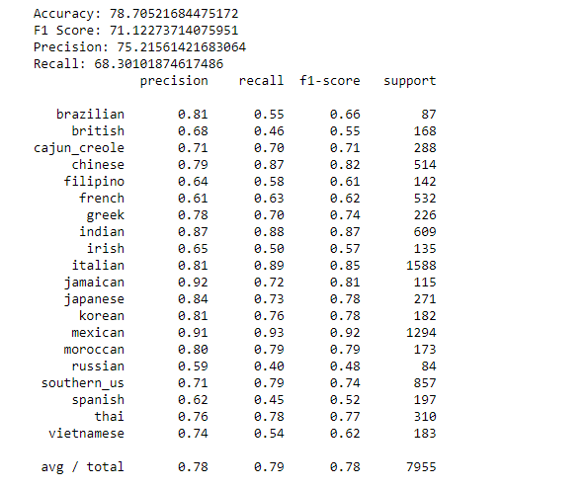
Implementation
Split the data into train and test data in 80:20 ratio.
Used different machine learning algorithms to find the algorithm which is having high accuracy in classifying the test data.
SVM algorithm performed better with 78.70% accuracy for the test data compared to Naïve bayes classifier and Logistic regression, so used SVM algorithm to predict the cuisine type.
Below is the metrics, we got for the SVM model.

Slide 8
Implementation
Scrapped the food article data from BBC Website in required format.
Converted the ingredients column into TF-IDF matrix like the data used for training.
Predicted the cuisine type using the SVM model built using Kaggle data set.
Stored the result in CSV and used it as the source for our webpage to filter and display the result.

Slide 9
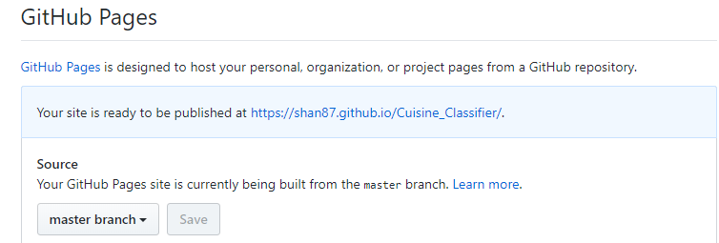
How to use
We have published our work in the below GitHub repository.
https://github.com/pnaveen4u87/Cuisine_Classifier
Fork the project to your GitHub Id and enable GitHub page in settings for this repository, if you want to use the web to filter and view the results
To fork and to enable the GitHub pages follow the steps below
Fork the project from https://github.com/pnaveen4u87/Cuisine_Classifier
Go to settings of the forked repository
Scroll down to GitHub Pages section and select “master branch” under source and save the settings. This will generate the URL for you to access the Cuisine classifier UI to view and filter your results.
The URL generated wont have the complete path. You need to add “cuisine_recipe.html” to the URL generated by GitHub so that the URL looks something like below
https://shan87.github.io/Cuisine_Classifier/cuisine_recipe.html

Slide 10
How to use
You can also download the repository and setup the folder in your machine.
If you download the repository and use the project, you will be able to see the results only in CSV and not in the web.
This tool is developed using Python 3.7.
To use the tool, make sure you have Python and Jupyter notebook installed in your machine.
The following are the folders/files used by the classifier model
Main Folder
Classifier.ipynb – Jupyter note book to run the classifier.
OutPut.csv – CSV file where the results will be saved by the classifier.
Main Folder / Data Folder
Data folder has 2 folders
Train folder which has the train data from Kaggle in json format.
Test folder which has the test data from BBC website in csv format.

Slide 11
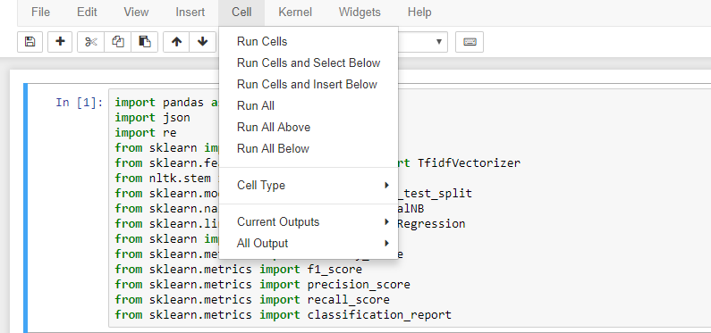
How to use
To run the classifier, open the classifier.ipynb in Jupyter notebook
If you want to provide new training data to the model, you can place the new training data in the train folder in json format like the one which is already available.
Provide the ingredients for the recipes for which you want find the cuisine type in the csv file in test folder.
Using Jupyter notebook run all the chunks of code using Run All option in the cell menu.
The classified results will be updated in the output.csv

Slide 12
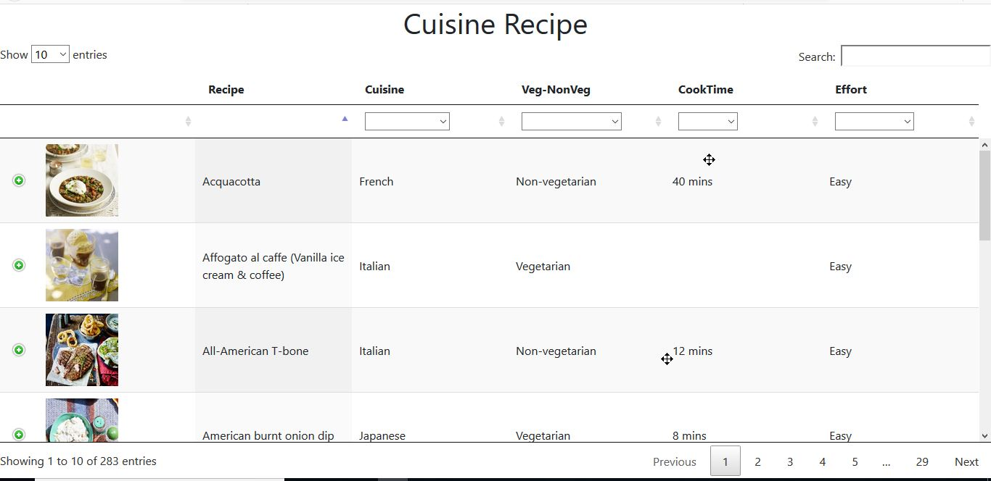
How to use
User Interface
Cuisine class webpage is implemented to view the list of recipes, ingredients which are categorized by the classifier to cuisine type and meal type.
If you have forked the project, you should access the UI using the URL that is generated in the GitHub Pages section of your repository settings.
UI works as below
Page is loaded with data table with all cuisine and recipe data.

Slide 13
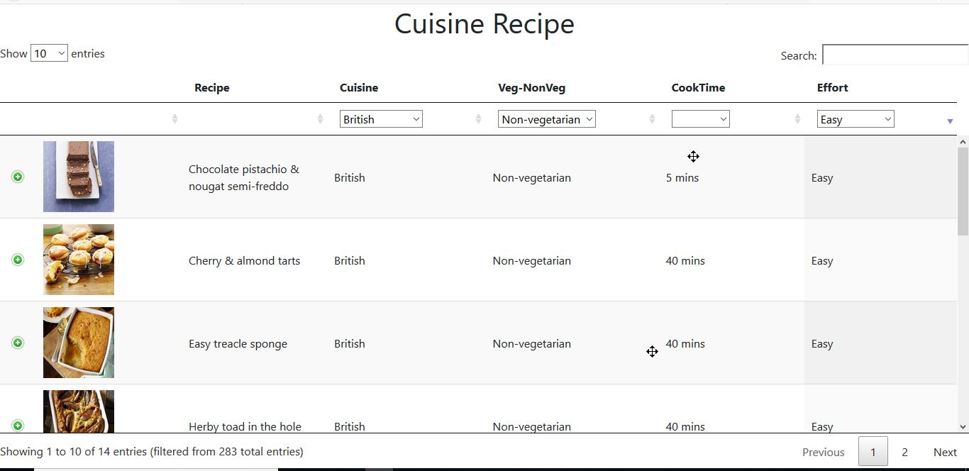
How to use
User Interface
User can select either Cuisine or Veg-NonVeg or Cook Time or Effort or all the options, the table will display the result based on user selection.

Slide 14
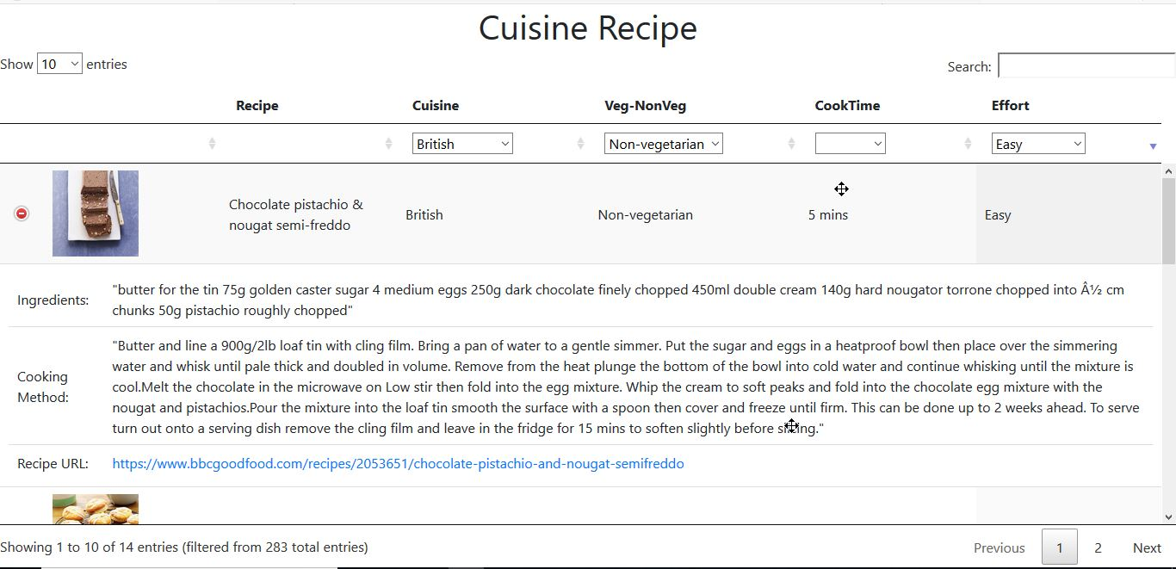
How to use
User Interface
The expand/collapse button will reveal information on the Ingredients, Cooking Method and Source recipe URL(link to the recipe)

Slide 15
Thank you

